Slide 1
Wawasee Community School Corporation
Community Engagement - Executive Summary
April 2023
Notes:
Steve Troyer - Introduction

Slide 2
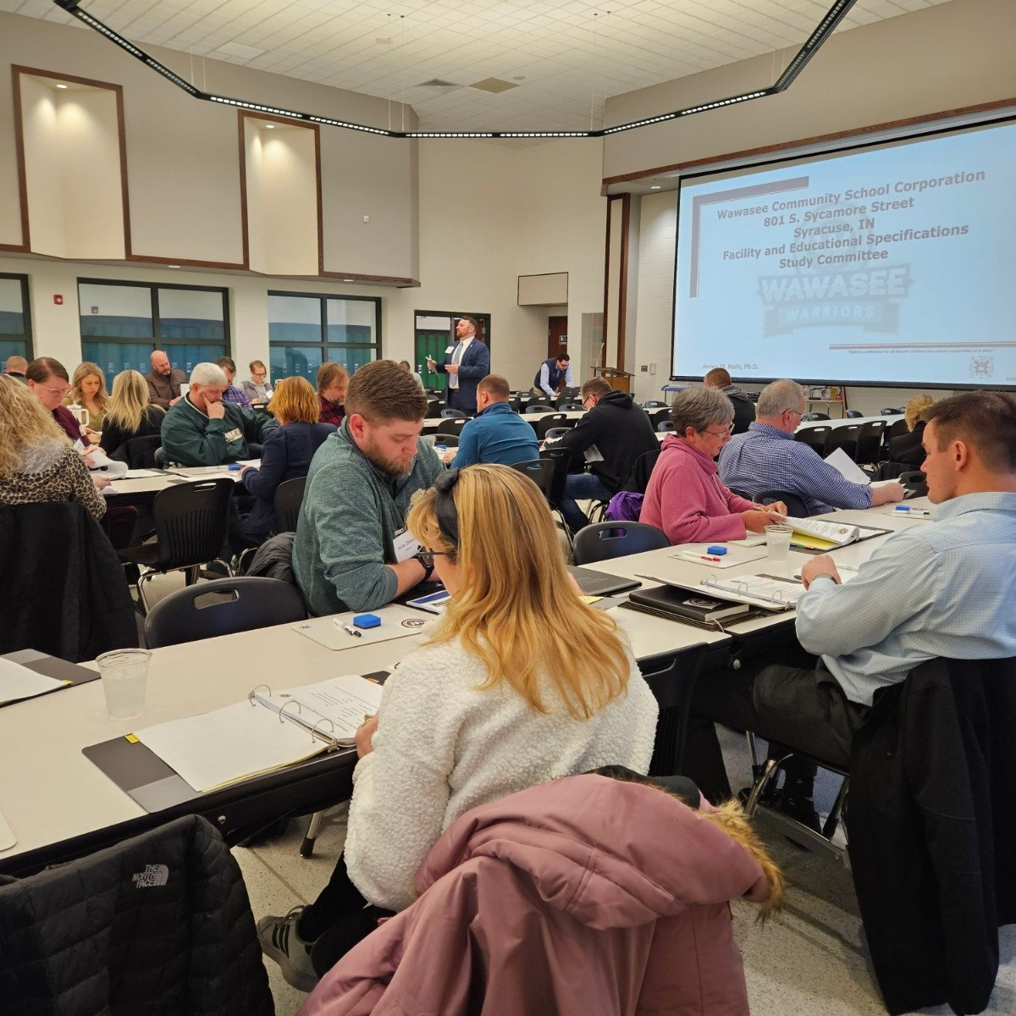
The Purpose and Process
The primary purpose was to study and discuss educational program and facility needs of the school corporation, and to provide the board with a list of options to consider based upon data and feedback from several studies.
44-Member Community Advisory Task Force was Assembled
Parents, patrons, community leaders, teachers, support staff, administrators and two board members.
Notes:
Michael Mettham

Slide 3
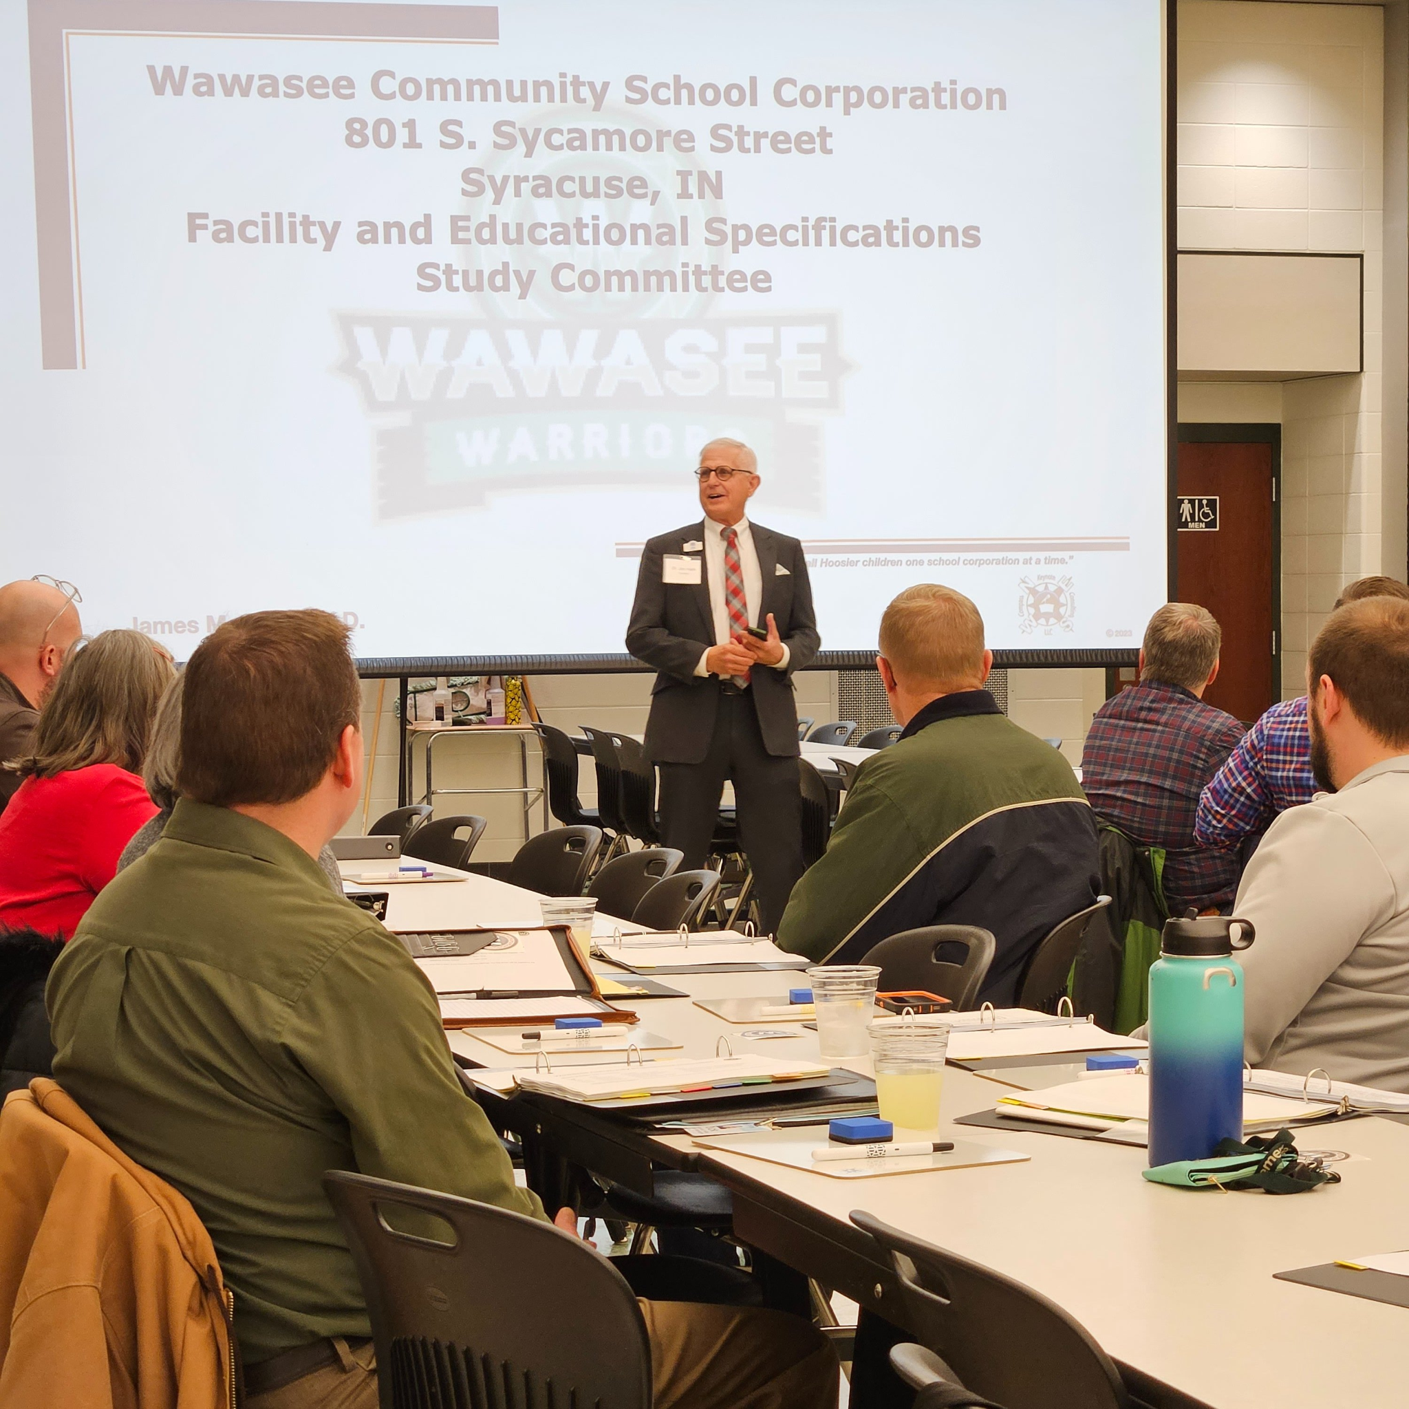
Disclaimers
Focus is on children
Data driven decisions
Instruction must drive construction
Safety must be a priority
Focus on the immediate needs first
Strive for curriculum and program equity
Maximum utilization of current facilities
Benefits of consolidating facilities
School grade level realignment
Curb appeal as related to the various school’s brand
Notes:
Jeff Dyson

Slide 4
Through the Lens of Our Vision and Mission
District Vision Statement
"Our students are confident, well-rounded citizens who positively impact their communities."
District Mission Statement
"Wawasee schools partner with students, families, and communities to meet the needs of all students and empower them to reach their highest potential."
Notes:
Jeff Dyson

Slide 5
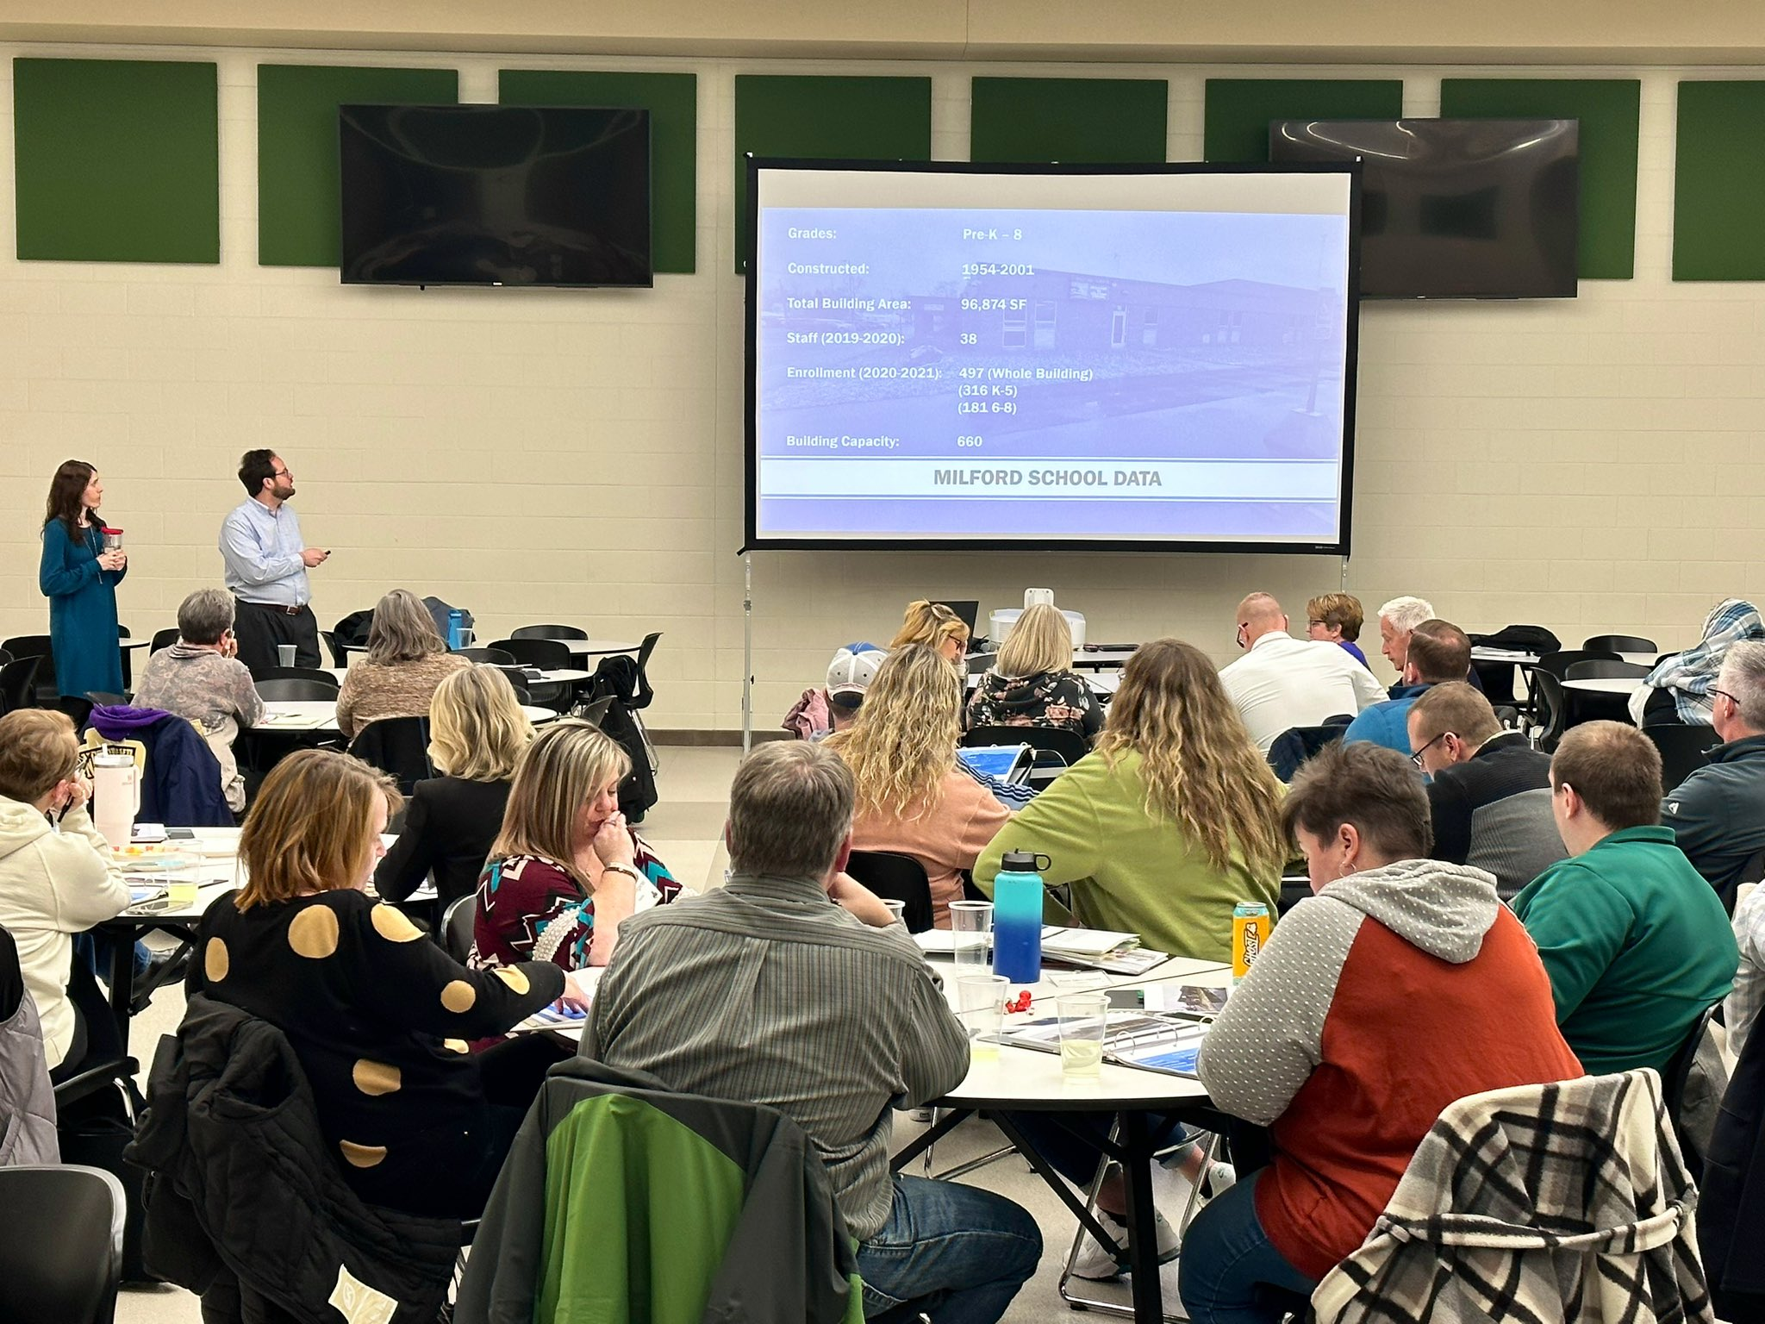
Process Structure
5 Meetings over the course of 1 month (1 in each school building)
Presentations on:
Public School Finance and Bond / Debt Capacity
Educational Program at Wawasee
Facilities Study by Barton Coe Vilamaa
Demographic Study by Dr. Jerry McKibben
School Tour led by building leaders
*90% total attendance rate for the 5 meetings.
Notes:
Karena Wilkinson

Slide 6
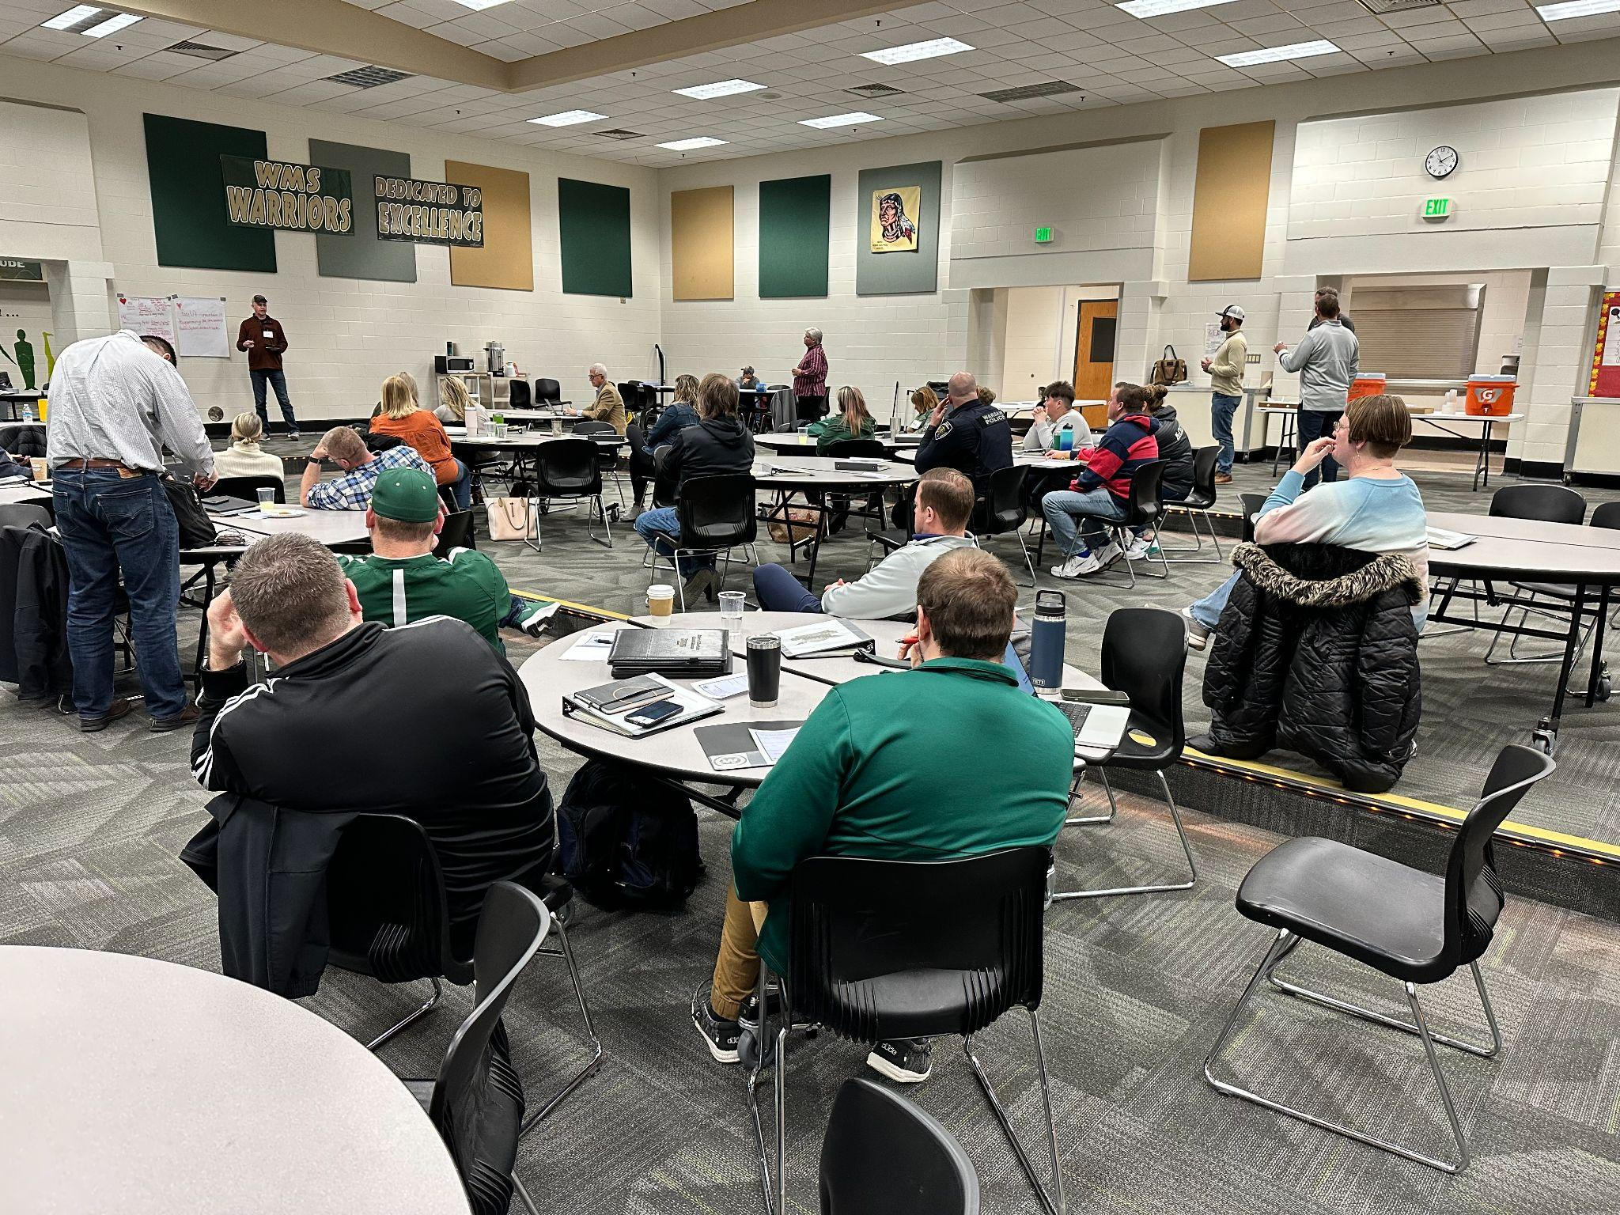
Final Work Session
The large group was divided into 4 smaller representative (equally mixed) groups to develop a list of ideas and options based upon the data and information learned during the process.
Groups were charged with developing options for the board to consider as they move forward with plans to renovate, build new, realign building grade levels, and/or consider closing or expanding any existing facilities.
Notes:
Karena Wilkinson

Slide 7
Focus Area 1 (Most Discussed)
Combine Milford Middle School with Wawasee Middle School and renovate or construct a new Milford Elementary School
New fieldhouse that could be shared by the school and community
Renovate or construct a new competitive swimming pool
New performing arts center
Notes:
Josh Weiland

Slide 8
Focus Area 2 (Frequently Discussed)
Expand STEAM/STEM/Robotics/CTE/AP Programs and Classroom Space
Update or replace the planetarium
Wawasee needs a marketing/communication strategy
Evaluate “Alternative Learning” facilities
Notes:
Jeff Dyson

Slide 9
Focus Area 3 (Somewhat Discussed)
Expand preschool space
Improve parent dropoff / pickup areas at the elementary schools
Playground Updates – Equality, Modern, and Safe
Make necessary improvements as needed to HVAC units
Notes:
Karena Wilkinson

Slide 10
Focus Area 4 (Additional Considerations)
Expand the middle school industrial technology areas
Turf baseball and softball fields
Consider outdoor classroom(s)
Improve and update entrances to all schools (curb appeal)
Update district wide radio system for emergencies.
Notes:
Michael Mettham

Slide 11
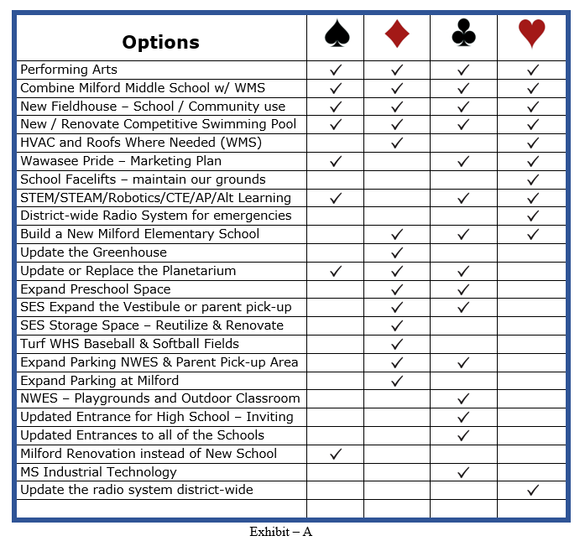
Discussion Analysis
Notes:
Josh Weiland

